Slide 1
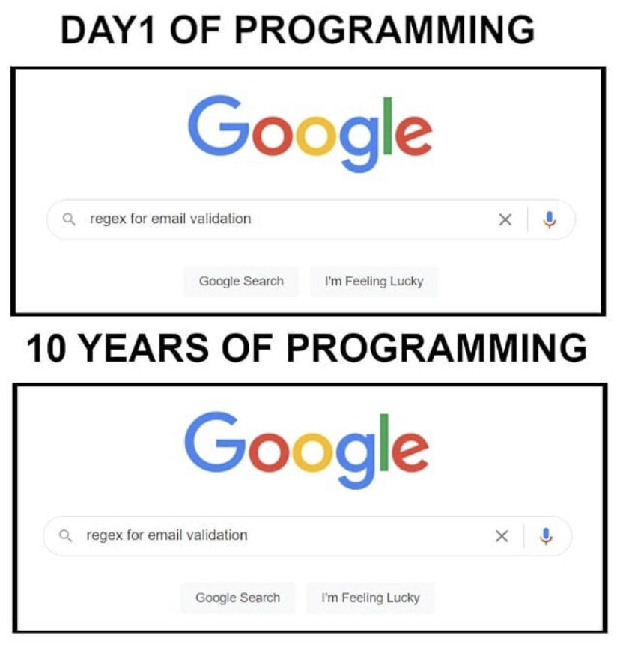

Slide 2
Agenda
Start | End | Item
 |  | Data For Modeling
 |  | Data Mining Workflows
 |  | Data Modification & Preprocessing
 |  | Business Case: Donor Bureau
 |  | Housekeeping, Reading & Homework

Slide 3
Data Structure for Analysis & Modeling
Often the 1st Column is a unique identifier but the identifier could also be a row attribute (not actually a vector)
name | mfr | type | calories | protein | fat | sodium | fiber | carbo | sugars | potass | vitamins | shelf | weight | cups | rating
100%_Bran | N | C | 70 | 4 | 1 | 130 | 10 | 5 | 6 | 280 | 25 | 3 | 1 | 0.33 | 68.40297
100%_Natural_Bran | Q | C | 120 | 3 | 5 | 15 | 2 | 8 | 8 | 135 | 0 | 3 | 1 | 1 | 33.98368
All-Bran | K | C | 70 | 4 | 1 | 260 | 9 | 7 | 5 | 320 | 25 | 3 | 1 | 0.33 | 59.42551
All-Bran_with_Extra_Fiber | K | C | 50 | 4 | 0 | 140 | 14 | 8 | 0 | 330 | 25 | 3 | 1 | 0.5 | 93.70491
Almond_Delight | R | C | 110 | 2 | 2 | 200 | 1 | 14 | 8 |  | 25 | 3 | 1 | 0.75 | 34.38484
Apple_Cinnamon_Cheerios | G | C | 110 | 2 | 2 | 180 | 1.5 | 10.5 | 10 | 70 | 25 | 1 | 1 | 0.75 | 29.50954
Apple_Jacks | K | C | 110 | 2 | 0 | 125 | 1 | 11 | 14 | 30 | 25 | 2 | 1 | 1 | 33.17409
Basic_4 | G | C | 130 | 3 | 2 | 210 | 2 | 18 | 8 | 100 | 25 | 3 | 1.33 | 0.75 | 37.03856
Bran_Chex | R | C | 90 | 2 | 1 | 200 | 4 | 15 | 6 | 125 | 25 | 1 | 1 | 0.67 | 49.12025
Bran_Flakes | P | C | 90 | 3 | 0 | 210 | 5 | 13 | 5 | 190 | 25 | 3 | 1 | 0.67 | 53.31381
Cap'n'Crunch | Q | C | 120 | 1 | 2 | 220 | 0 | 12 | 12 | 35 | 25 | 2 | 1 | 0.75 | 18.04285
Generally we will use data frames to avoid complexity but you will be exposed to other data types.

Slide 4
Data Structure for Analysis & Modeling
Informative features are usually independent & do not lend information to other rows (auto-correlation). Can be called informative columns, independent variables, or features.
Remember in a DF, these can be mixed with decimals, integers, factors, strings, T/F.
name | mfr | type | calories | protein | fat | sodium | fiber | carbo | sugars | potass | vitamins | shelf | weight | cups | rating
100%_Bran | N | C | 70 | 4 | 1 | 130 | 10 | 5 | 6 | 280 | 25 | 3 | 1 | 0.33 | 68.40297
100%_Natural_Bran | Q | C | 120 | 3 | 5 | 15 | 2 | 8 | 8 | 135 | 0 | 3 | 1 | 1 | 33.98368
All-Bran | K | C | 70 | 4 | 1 | 260 | 9 | 7 | 5 | 320 | 25 | 3 | 1 | 0.33 | 59.42551
All-Bran_with_Extra_Fiber | K | C | 50 | 4 | 0 | 140 | 14 | 8 | 0 | 330 | 25 | 3 | 1 | 0.5 | 93.70491
Almond_Delight | R | C | 110 | 2 | 2 | 200 | 1 | 14 | 8 |  | 25 | 3 | 1 | 0.75 | 34.38484
Apple_Cinnamon_Cheerios | G | C | 110 | 2 | 2 | 180 | 1.5 | 10.5 | 10 | 70 | 25 | 1 | 1 | 0.75 | 29.50954
Apple_Jacks | K | C | 110 | 2 | 0 | 125 | 1 | 11 | 14 | 30 | 25 | 2 | 1 | 1 | 33.17409
Basic_4 | G | C | 130 | 3 | 2 | 210 | 2 | 18 | 8 | 100 | 25 | 3 | 1.33 | 0.75 | 37.03856
Bran_Chex | R | C | 90 | 2 | 1 | 200 | 4 | 15 | 6 | 125 | 25 | 1 | 1 | 0.67 | 49.12025
Bran_Flakes | P | C | 90 | 3 | 0 | 210 | 5 | 13 | 5 | 190 | 25 | 3 | 1 | 0.67 | 53.31381
Cap'n'Crunch | Q | C | 120 | 1 | 2 | 220 | 0 | 12 | 12 | 35 | 25 | 2 | 1 | 0.75 | 18.04285
Generally we will use data frames to avoid complexity but you will be exposed to other data types.

Slide 5
Data Structure for Analysis & Modeling
If we are doing supervised learning, there is a dependent variable.
This is the outcome and is “dependent” on the informative columns. An analysis with this vector can be binary, classification, or predictive.
name | mfr | type | calories | protein | fat | sodium | fiber | carbo | sugars | potass | vitamins | shelf | weight | cups | rating
100%_Bran | N | C | 70 | 4 | 1 | 130 | 10 | 5 | 6 | 280 | 25 | 3 | 1 | 0.33 | 68.40297
100%_Natural_Bran | Q | C | 120 | 3 | 5 | 15 | 2 | 8 | 8 | 135 | 0 | 3 | 1 | 1 | 33.98368
All-Bran | K | C | 70 | 4 | 1 | 260 | 9 | 7 | 5 | 320 | 25 | 3 | 1 | 0.33 | 59.42551
All-Bran_with_Extra_Fiber | K | C | 50 | 4 | 0 | 140 | 14 | 8 | 0 | 330 | 25 | 3 | 1 | 0.5 | 93.70491
Almond_Delight | R | C | 110 | 2 | 2 | 200 | 1 | 14 | 8 |  | 25 | 3 | 1 | 0.75 | 34.38484
Apple_Cinnamon_Cheerios | G | C | 110 | 2 | 2 | 180 | 1.5 | 10.5 | 10 | 70 | 25 | 1 | 1 | 0.75 | 29.50954
Apple_Jacks | K | C | 110 | 2 | 0 | 125 | 1 | 11 | 14 | 30 | 25 | 2 | 1 | 1 | 33.17409
Basic_4 | G | C | 130 | 3 | 2 | 210 | 2 | 18 | 8 | 100 | 25 | 3 | 1.33 | 0.75 | 37.03856
Bran_Chex | R | C | 90 | 2 | 1 | 200 | 4 | 15 | 6 | 125 | 25 | 1 | 1 | 0.67 | 49.12025
Bran_Flakes | P | C | 90 | 3 | 0 | 210 | 5 | 13 | 5 | 190 | 25 | 3 | 1 | 0.67 | 53.31381
Cap'n'Crunch | Q | C | 120 | 1 | 2 | 220 | 0 | 12 | 12 | 35 | 25 | 2 | 1 | 0.75 | 18.04285
Generally we will use data frames to avoid complexity but you will be exposed to other data types.

Slide 6
Agenda
Start | End | Item
 |  | Data For Modeling
 |  | Data Mining Workflows
 |  | Data Modification & Preprocessing
 |  | Business Case: Donor Bureau
 |  | Housekeeping, Reading & Homework

Slide 7
Modeling Process
SEMMA (from SAS)
In this course…
1. Sample
In this course, data sets are curated for you. Sampling is done to avoid overfitting.
2. Explore
As part of your case analysis you perform basic exploratory data analysis (EDA)
3. Modify
4. Model
5. Assess
The first day we discussed data mining and structure. Week 2 was devoted to basics of R then how to sample, explore and visualize data. Now we will modify data for modeling!

Slide 8
In addition to SEMMA, Data Mining (from the book)
Define/understand purpose
Obtain data (may involve random sampling)
Explore, clean, pre-process data
Reduce the data; if supervised DM, partition it
Specify task (classification, clustering, etc.)
Choose the techniques (regression, CART, neural networks, etc.)
Iterative implementation and “tuning”
Assess results – compare models
Deploy best model
The book’s process is excellent but is focused largely on the modeling process not how the process is part of a business context or if the effort doesn’t require a model.

Slide 9
Data Mining in a Complete Business Workflow
Iterative Business Data Mining Project Life Cycle
Problem Definition
Identify Available Data Sources
EDA
Perform Analyssis
Assessment
Communicate Results
Document
Problem Formulation.
Define data requirements
Explore the data
Perform Analysis & Create Project Artifacts
Asses/Adjust the Project Artifacts
Communicate Results
Document to make it repeatable
Deploy & Monitor
In this view the steps of a project are not solely for modeling, more iterative and not in isolation because the results are communicated to stakeholders.

Slide 10
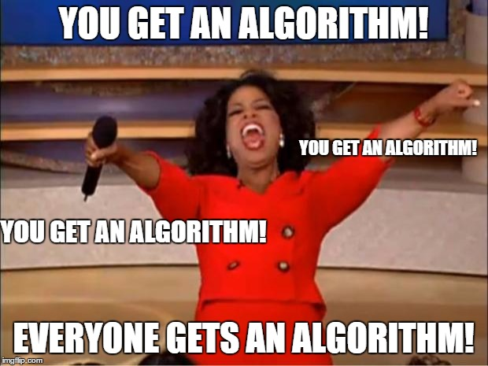
What is a model?
An model is a set of rules governing actions or phenomena.
Empirical Support without math
Your brain:
Algo#1: “fur” =Y, “tail”=Y, “claws”=Y, “meow”=Y therefore high probability that’s a cat
Algo#2: “another meme”=Y, “short & bald professor”=Y therefore “professor trying too hard to be cool”
Algorithms or mental models of reality can be correct or lead you to incorrect assumptions.

Slide 11
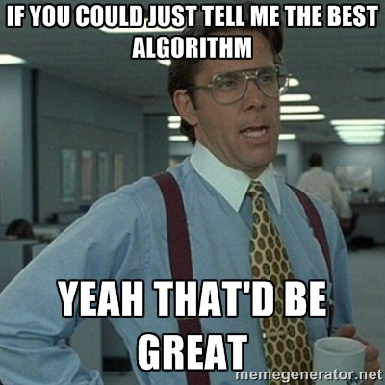
What is a model?
A model is a set of rules predicting actions or phenomena.
Empirical Support w/math
The way you instruct the rules to be constructed is the algorithm (KNN, RF, LogReg etc)
Computers can learn complex representations of phenomena
Just like mental algorithms, the observations we give a mathematical algorithm which result in a final model (set of rules) can lead to correct or incorrect assumptions. “Garbage in…Garbage out.”

Slide 12
Vocabulary
What is an algorithm?
What is a model?
The method you choose to construct the model rules.
The way you expect to learn about reality.
A set of learned patterns describing phenomena.
Some representation of “reality”.
The algorithm produces the model.

Slide 13

Don’t be Dale!
Force stakeholders to agree on a problem, plan and output.
Put together a plan, adjust the plan as needed…but have a plan!!

Slide 14

Common Pitfalls
State the problem in business terms. Avoid open ended questions or just curiosity analysis.
Don’t measure things twice (multi-collinearity) like Celsius & Fahrenheit in the same data set
Understand data integrity & human behavior
Customers filling out surveys are already self selecting & therefore biased compared to all customers
The choice of what to measure will impact the human behavior ie AHT, or FCR
Beware of perfection
Perfectly aligned analyses and SME expectations seldom occur
Model perfection likely means you have an error
Beware of data leak & misunderstanding of the project!
Including “expired” patients when predicting hospital readmissions

Slide 15
Agenda
Start | End | Item
 |  | Data For Modeling
 |  | Data Mining Workflows
 |  | Data Modification & Preprocessing
 |  | Business Case: Donor Bureau
 |  | Housekeeping, Reading & Homework

Slide 16
Modeling Process
SEMMA (from SAS)
In this course…
1. Sample
In this course, most data sets are curated for you.
2. Explore
As part of your course analysis you perform basic exploratory data analysis (EDA)
3. Modify
Data cleanup, Dimension Reduction, Feature Engineering & Feature Enrichment
4. Model
5. Assess
Often data is sampled from a large database so you can more quickly explore, apply methods and prototype before reassessing on full data.

Slide 17
PreProcessing
Many algorithms cannot accept the data directly.
Thus you must preprocess your data before training.
Common Pre-Processing
Categorical Variables
Common Pre-Processing
Numeric Variables
Dummy Variables
Binning Low Frequency Levels
Changing to Numeric for Ordinal
Deal with Missing Levels
Deal with Missing
Outlier Detection
Binning
The book does these steps in a traditional manner but we will use an easier method called variable treatment (vtreat). Review the book if you want to see the manual methods.

Slide 18

Dummy Variables
Always “1 Less than the State of Nature”
2 States of Nature = 1 Light Switch or “dummy variable”
Dog or Cat needs one column where dog =1, cat=0
If the column has a 0 then its a cat.
AI Generated: Stable Diffusion Picture
Represent non-numeric information as light switches.
Kwartler

Slide 19

Dummy Variables
Always “1 Less than the State of Nature”
3 States of Nature = 2 Light Switches or “dummy variables”
If both columns are 0 then by default, this is the same information as the row having a fish.
Dog | Cat
1 | 0
0 | 1
0 | 0
AI Generated: Stable Diffusion Picture
Represent non-numeric information as light switches.
Kwartler

Slide 20

Dummy Variables
Dummy Variables represent category levels as 1/0 within new vectors. For some approaches, this lets the algorithm understand the information.
Consider this data:
CuID | Gender | Profession | Affiliation
CU43E439 | Male | Nurse | Democrat
CU36E506 | Male | Teacher | Independent
CU91E65 | Female | Manager | Republican
CU17E255 | Male | Student | Democrat
CU27E792 | Female | Executive
CU74E430 | Female | Manager | Republican
CU25E466 | Female | Teacher | Democrat
Kwartler

Slide 21
Dummy Variables
Dummy Variables represent category levels as 1/0 within new vectors. For some approaches, this lets the algorithm understand the information.
Consider this data:
Through EDA you realize:
CuID | Gender | Profession | Affiliation
CU43E439 | Male | Nurse | Democrat
CU36E506 | Male | Teacher | Independent
CU91E65 | Female | Manager | Republican
CU17E255 | Male | Student | Democrat
CU27E792 | Female | Executive
CU74E430 | Female | Manager | Republican
CU25E466 | Female | Teacher | Democrat
You wouldn’t use the ID var for training
Gender has 2 levels
Profession has 5 levels
Affiliation has 3 levels & missing
Kwartler

Slide 22
Dummy Variables
Always make dummy variables “1 less than the state of the data nature”
Consider this data:
CuID | Gender | Profession | Affiliation
CU43E439 | Male | Nurse | Democrat
CU36E506 | Male | Teacher | Independent
CU91E65 | Female | Manager | Republican
CU17E255 | Male | Student | Democrat
CU27E792 | Female | Executive
CU74E430 | Female | Manager | Republican
CU25E466 | Female | Teacher | Democrat
CuID | Gender__Male | Profession_Nurse | Profession_Teacher | Profession_Manager | Profession_Student | Affiliation_D | Affiliation_I | Affiliation_Missing
CU43E439 | 1 | 1 | 0 | 0 | 0 | 1 | 0 | 0
CU36E506 | 1 | 0 | 1 | 0 | 0 | 0 | 1 | 0
CU91E65 | 0 | 0 | 0 | 1 | 0 | 0 | 0 | 0
CU17E255 | 1 | 0 | 0 | 0 | 1 | 1 | 0 | 0
CU27E792 | 0 | 0 | 0 | 0 | 0 | 0 | 0 | 1
CU74E430 | 0 | 0 | 0 | 1 | 0 | 0 | 0 | 0
CU25E466 | 0 | 0 | 1 | 0 | 0 | 1 | 0 | 0
A light switch has 2 states, on/off, yet you only need 1 switch. The same is true as more levels are added, you don’t need one for each level.
Kwartler
Notes:
Multicolinearity – counting things twice, algo understands all 0’s represents a piece of information.
Missing “flag” - often has a hidden meaning such as data integrity or data collection. Sometimes these issues are systematic & informative

Slide 23
Dummy Variables
Always make dummy variables “1 less than the state of the data nature”
Dummy Data:
CuID | Gender__Male | Profession_Nurse | Profession_Teacher | Profession_Manager | Profession_Student | Affiliation_D | Affiliation_I | Affiliation_Missing
CU43E439 | 1 | 1 | 0 | 0 | 0 | 1 | 0 | 0
CU36E506 | 1 | 0 | 1 | 0 | 0 | 0 | 1 | 0
CU91E65 | 0 | 0 | 0 | 1 | 0 | 0 | 0 | 0
CU17E255 | 1 | 0 | 0 | 0 | 1 | 1 | 0 | 0
CU27E792 | 0 | 0 | 0 | 0 | 0 | 0 | 0 | 1
CU74E430 | 0 | 0 | 0 | 1 | 0 | 0 | 0 | 0
CU25E466 | 0 | 0 | 1 | 0 | 0 | 1 | 0 | 0
Applying Judgment:
CuID | Gender__Male | Profession_LowCount | Profession_Teacher | Profession_Manager | Affiliation_D | Affiliation_IndependentMissing
CU43E439 | 1 | 1 | 0 | 0 | 1 | 0
CU36E506 | 1 | 0 | 1 | 0 | 0 | 1
CU91E65 | 0 | 0 | 0 | 1 | 0 | 0
CU17E255 | 1 | 1 | 0 | 0 | 1 | 0
CU27E792 | 0 | 0 | 0 | 0 | 0 | 1
CU74E430 | 0 | 0 | 0 | 1 | 0 | 0
CU25E466 | 0 | 0 | 1 | 0 | 1 | 0
Never throw the “kitchen sink” at an algo, exercise your problem knowledge to reduce the number of vectors.
Kwartler
Notes:
Perhaps you can combine independent voters with someone that didn’t register.

Slide 24
Numeric Variables
Numeric variables need to be examined, corrected and missing flags need to be created.
Consider this data:
With domain expertise you realize:
Model | mpg | cyl | disp | hp | drat | wt | qsec
Mazda RX4 | 21 | 6 | 160 | 110 | 3.9 | 2.62
Mazda RX4 Wag | 21 | 6 | 160 | -110 | 3.9 | 2.875 | 17.02
Datsun 710 | 122.8 | NA | 108 | 93 | 3.85 | 2.32 | 18.61
Hornet 4 Drive | 21.4 | 6 | 258 | 110 | 3.08 | 3.215 | 19.44
Hornet Sportabout | 18.7 | 8 | ? | 175 | 3.15 | 3.44 | 17.02
Valiant | 18.1 | 6 | 225 | 105 | 2.76 | NA | 20.22
Duster 360 | 14.3 | 8 | 360 | 245 | 3.21 | 3.57 | 15.84
Merc 240D | 24.4 | 4 | 146.7 | 62 | 3.69 | 3.19
Merc 230 | 22.8 | 4 | 140.8 | 95 | 3.92 | 3.15 | 22.9
Merc 280 | 19.2 | 6 | 167.6 | 123 | 3.92 | 3.44 | 18.3
Its unlikely a car has 122mpg
No way -110 horsepower!
Through EDA you realize:
Missing values are blank, NA, and “?”
Kwartler

Slide 25
Outlier Numeric Variables
Outliers can be removed or the values can be replaced with imputation.
Consider this data:
Drop a row if:
You have many other records for training
The record contains multiple integrity issues
Model | mpg | cyl | disp | hp | drat | wt | qsec
Mazda RX4 | 21 | 6 | 160 | 110 | 3.9 | 2.62
Mazda RX4 Wag | 21 | 6 | 160 | -110 | 3.9 | 2.875 | 17.02
Datsun 710 | 122.8 | NA | 108 | 93 | 3.85 | 2.32 | 18.61
Hornet 4 Drive | 21.4 | 6 | 258 | 110 | 3.08 | 3.215 | 19.44
Hornet Sportabout | 18.7 | 8 | ? | 175 | 3.15 | 3.44 | 17.02
Valiant | 18.1 | 6 | 225 | 105 | 2.76 | NA | 20.22
Duster 360 | 14.3 | 8 | 360 | 245 | 3.21 | 3.57 | 15.84
Merc 240D | 24.4 | 4 | 146.7 | 62 | 3.69 | 3.19
Merc 230 | 22.8 | 4 | 140.8 | 95 | 3.92 | 3.15 | 22.9
Merc 280 | 19.2 | 6 | 167.6 | 123 | 3.92 | 3.44 | 18.3
Impute (use a method to change the value):
Hotdeck – choose a random value in the vector say 19.2
Mean Imputation – mean avg of vector
Median Imputation – median avg
Train an algorithm to fill in the values (KNN)
Kwartler
Notes:
Document document document!!

Slide 26
Detecting Outliers
An outlier is an observation that is “extreme”, being distant from the rest of the data (definition of “distant” is deliberately vague)
Outliers can have disproportionate influence on models
An important step in data pre-processing/EDA is detecting outliers
Once detected, domain knowledge is required to determine if it is an error, or truly extreme.
Correct them to a more normal (avg) value?
Remove the record altogether?
In the the case, look for and throw out outliers if it doesn’t help with your data narrative.
Kwartler

Slide 27
Detecting Outliers
In some contexts, finding outliers is the purpose of the DM exercise (airport security screening). This is called “anomaly detection”.
Kwartler

Slide 28
Missing Numeric Variables
Imputation is a best practice over to fill in for missing numeric values. Usually start with an easy method like mean imputation.
Drop a row if:
You have many other records for training
The record contains multiple integrity issues
Model | mpg | FixMPG
Mazda RX4 | 21 | 0
Mazda RX4 Wag | 21 | 0
Datsun 710 | 20.1 | 1
Hornet 4 Drive | 21.4 | 0
Hornet Sportabout | 18.7 | 0
Valiant | 18.1 | 0
Duster 360 | 14.3 | 0
Merc 240D | 24.4 | 0
Merc 230 | 22.8 | 0
Merc 280 | 19.2 | 0
Impute (use a method to change the value):
Hotdeck
Mean
Median
Algorithm (KNN)
Kwartler
Notes:
Changed mpg to mean avg
Document document document
add flag

Slide 29
Original Data
Imputation through domain expertise can be VERY time consuming but is sometimes worth it though not often.
Model | mpg | cyl | disp | hp | drat | wt | qsec
Mazda RX4 | 21 | 6 | 160 | 110 | 3.9 | 2.62
Mazda RX4 Wag | 21 | 6 | 160 | -110 | 3.9 | 2.875 | 17.02
Datsun 710 | 122.8 | NA | 108 | 93 | 3.85 | 2.32 | 18.61
Hornet 4 Drive | 21.4 | 6 | 258 | 110 | 3.08 | 3.215 | 19.44
Hornet Sportabout | 18.7 | 8 | ? | 175 | 3.15 | 3.44 | 17.02
Valiant | 18.1 | 6 | 225 | 105 | 2.76 | NA | 20.22
Duster 360 | 14.3 | 8 | 360 | 245 | 3.21 | 3.57 | 15.84
Merc 240D | 24.4 | 4 | 146.7 | 62 | 3.69 | 3.19
Merc 230 | 22.8 | 4 | 140.8 | 95 | 3.92 | 3.15 | 22.9
Merc 280 | 19.2 | 6 | 167.6 | 123 | 3.92 | 3.44 | 18.3
Drop a row if:
You have many other records for training
The record contains multiple integrity issues
Impute (use a method to change the value):
Hotdeck
Mean
Median
Algorithm (KNN)
Kwartler
Notes:
Document document document!!

Slide 30
Missing Numeric Variables
Imputation through domain expertise can be VERY time consuming but is sometimes worth it though not often.
Consider this data:
Model | mpg | cyl | disp | hp | drat | wt | qsec
Mazda RX4 | 21 | 6 | 160 | 110 | 3.9 | 2.62 | 17.02
Mazda RX4 Wag | 21 | 6 | 160 | 124.2 | 3.9 | 2.875 | 17.02
Datsun 710 | 20.1 | 8 | 108 | 93 | 3.85 | 2.32 | 18.61
Hornet 4 Drive | 21.4 | 6 | 258 | 110 | 3.08 | 3.215 | 19.44
Hornet Sportabout | 18.7 | 8 | 191.8 | 175 | 3.15 | 3.44 | 17.02
Valiant | 18.1 | 6 | 225 | 105 | 2.76 | 3.15 | 20.22
Duster 360 | 14.3 | 8 | 360 | 245 | 3.21 | 3.57 | 15.84
Merc 240D | 24.4 | 4 | 146.7 | 62 | 3.69 | 3.19 | 22.9
Merc 230 | 22.8 | 4 | 140.8 | 95 | 3.92 | 3.15 | 22.9
Merc 280 | 19.2 | 6 | 167.6 | 123 | 3.92 | 3.44 | 18.3
Impute (use a method to change the value):
-110 looks like a data entry issue & other Mazda has 110.
Mean Imputation
191.8 is the average for the column
Other columns could be “hotdeck’ed”
Kwartler
Notes:
Hotdeck for disp hp and wt
Document document document
add flag

Slide 31
Missing Flags
Add missing indicator dummy variables similar to the categorical exercise.
Consider this data:
Model | mpg | cyl | disp | hp | drat | wt | qsec | missingMPG | missingCyl | missingDisp | Adjust_HP | missingWT | missingQSec
Mazda RX4 | 21 | 6 | 160 | 110 | 3.9 | 2.62 | 17.02 | 0 | 0 | 0 | 0 | 0 | 1
Mazda RX4 Wag | 21 | 6 | 160 | 124.2 | 3.9 | 2.875 | 17.02 | 0 | 0 | 0 | 1 | 0 | 0
Datsun 710 | 20.1 | 8 | 108 | 93 | 3.85 | 2.32 | 18.61 | 1 | 1 | 0 | 0 | 0 | 0
Hornet 4 Drive | 21.4 | 6 | 258 | 110 | 3.08 | 3.215 | 19.44 | 0 | 0 | 0 | 0 | 0 | 0
Hornet Sportabout | 18.7 | 8 | 191.8 | 175 | 3.15 | 3.44 | 17.02 | 0 | 0 | 1 | 0 | 0 | 0
Valiant | 18.1 | 6 | 225 | 105 | 2.76 | 3.15 | 20.22 | 0 | 0 | 0 | 0 | 1 | 0
Duster 360 | 14.3 | 8 | 360 | 245 | 3.21 | 3.57 | 15.84 | 0 | 0 | 0 | 0 | 0 | 0
Merc 240D | 24.4 | 4 | 146.7 | 62 | 3.69 | 3.19 | 22.9 | 0 | 0 | 0 | 0 | 0 | 1
Merc 230 | 22.8 | 4 | 140.8 | 95 | 3.92 | 3.15 | 22.9 | 0 | 0 | 0 | 0 | 0 | 0
Merc 280 | 19.2 | 6 | 167.6 | 123 | 3.92 | 3.44 | 18.3 | 0 | 0 | 0 | 0 | 0 | 0
Kwartler
Notes:
Hotdeck for disp hp and wt
Document document document
add flag

Slide 32

Feature Engineering- Still Pre-Processing!!
Once you have your data identified, collected and organized, you may want to create new vectors using existing data to aid the analysis.
Feature engineering or “feature crossing” is the act of using existing data to form new data inputs for analysis. For example, dividing one data point by another to derive a new data point.
Kwartler

Slide 33
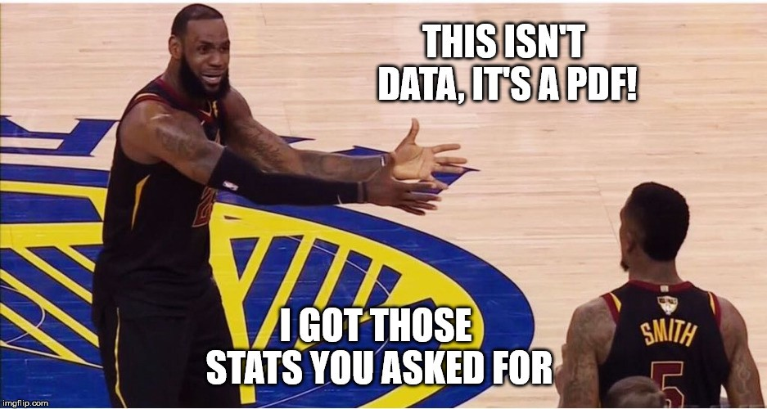
What is Feature Engineering?
Using qualitative or technical expertise to derive new features for machine learning.
Example
Using regular season stats predict the championship outcome:
Raw Data:
Total Rebounds (2017-18): 705
Total Games: 82
LBJ triple doubles: 10
Engineered
Name | Value | Type | Reasoning
Rebounds per Game | 8.6 | Technical | Simple ratio of two team level stats
Percent of Games that Lebron James has a “triple double” | 10/82 = 12% | Qualitative | Capturing information about the best player’s performance e.g. getting double digit stats in 3 of assists, blocks, points, rebounds, or steals
Kwartler

Slide 34
Why is Feature Engineering Effective?
Using qualitative or technical expertise to derive new features for machine learning.
$$f\left(Modeling Results\right)=the Algo+Parameters+Data provided$$
Better features means flexibility.
less than optimal models can still yield good results
Better features means simpler models.
less than optimal parameters can still yield good results
Better features means better results.
“The algorithms we used are very standard for Kagglers. We spent most of our efforts in feature engineering.” Xavier Conort describing his winning “Flight Quest” submission for $250,000 prize
Way to differentiate & squeeze out more accuracy
Kwartler

Slide 35
Example Feature Engineering Methods
library(vtreat)
Automatic variable treatment functions
Hand-Coded Variables
Subject Matter Experts tell you which variables to interact
Kwartler

Slide 36
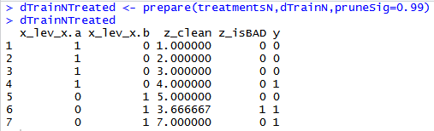
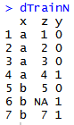
Variable Treatment: library(vtreat)
Vtreat automates some data cleaning, imputation and engineers specific response encoded variables.
Step 3
treatmentsN <- designTreatmentsN(...)
“Prepare” Data into a treated Modeling Matrix
Step 2
“Design Treatment” - Categorical or Numeric outcome
Step 1
Organize Informative Data
Kwartler

Slide 37
Vtreat adjusts data in many ways.
Action | Type | Description
Imputation | Cleaning | Na, Nan, Inf replacement
Imputation Indicator | Cleaning | Append a binary column as imputation flag
Dummy Variables | Cleaning | Create dummy variables for categorical variables
Constant Attribute Suppression | Cleaning | Remove variables with a single value.
Level Deviation –”cat_D” | Engineering | A “deviation fact” about a categorical level. Tells us if ‘y’ is concentrated or diffuse when conditioned on the observed level of the original categorical variable.
Level Prevalence- “cat_P” | Engineering | A “prevalence fact” about a categorical level. Tells us if the original level was rare or common.
Estimated Single Variable Effects – “cat_B” = categorical outcome w/Bayesian “cat_N” = numeric outcome w/Regression | Engineering | A single variable Bayesian model of the change in logit-odds in outcome from mean distribution conditioned on the observed value of the original variable. A single variable regression model of the difference in outcome expectation conditioned on the observed value of the original variable.
Rare Cats* | Engineering | For categorical levels below a frequency threshold, pool different levels into a common “rare-level” variable
Kwartler
Notes:
Does NOT check for co-linear variables
Does not perform outlier suppression

Slide 38
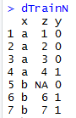
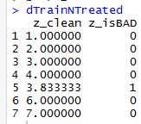
Mean Imputation - PreProcessing
Most of the time we will use vtreat to clean data…its faster and easier.
Vtreat Actions | Common Name
NA, NAN, and Infinity replaced with mean | Mean imputation
When a numeric value is missing
Replace that value with the mean average
Not applicable for categorical variables
Design a treatment plan and apply it.
Kwartler

Slide 39
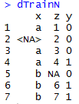
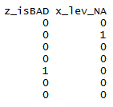
Missing Flags- PreProcessing
Vtreat Actions | Common Name
Indicator | Missing indicator
When a numeric value is missing
Add a missing flag variable
When a factor level is missing
Add a missing flag variable
Design a treatment plan and apply it.
Kwartler

Slide 40
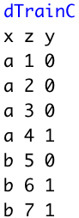
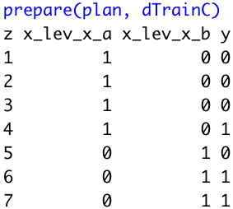
Dummy Variables - PreProcessing
Vtreat Actions | Common Name
Indicator variables | Dummy variable
Not applicable for numeric values
For each factor level, will create dummy variables.
Design a treatment plan and apply it.
Beware! Since some algorithms don’t care, vtreat will return ALL dummy variables and not drop one to represent all 0s.
Kwartler

Slide 41
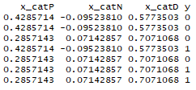
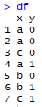
Vtreat Engineered CAT Variables Example
What is the propensity for success difference between overall success in a category level compared to overall occurrence of success?
Simple Calculations
The propensity of A to Y=1 is less than average Y’s occurence
CatN (Numeric):
X equals A & Y equals 1: (1/3) minus
Overall Y value equals 1: (3/7)
0.33 - .42 =
-0.0952381
Step 3*
“Prepare” Data into a treated Modeling Matrix
*abridged data shown
Step 2
“Design Treatment” - Categorical or Numeric
treatmentsN <- designTreatmentsN(...)
Step 1
Organize a Modeling Matrix
Kwartler

Slide 42
Vtreat Engineered CAT Variables Example
How diffuse is success within a category level?
Simple Calculations
The standard deviation of Y for level B captures the relationship’s distribution
CatD (Deviation):
Level B sd(c(0,1)) = 0.7071068
Step 3*
“Prepare” Data into a treated Modeling Matrix
*abridged data shown
Step 2
“Design Treatment” - Categorical or Numeric
treatmentsN <- designTreatmentsN(...)
Step 1
Organize a Modeling Matrix
Kwartler

Slide 43
Vtreat Engineered CAT Variables Example
Overall, how prevalent is a category level regardless of the outcome among all observations?
Simple Calculations
How prevelant is C among all observations i.e. is it a rare event?
Cat P (Prevalence):
Level C Occurred (2/7) = 0.2857143
Step 3*
“Prepare” Data into a treated Modeling Matrix
*abridged data shown
Step 2
“Design Treatment” - Categorical or Numeric
treatmentsN <- designTreatmentsN(...)
Step 1
Organize a Modeling Matrix
Kwartler

Slide 44
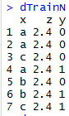
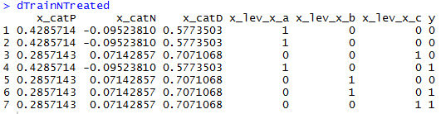
Non-Informative Check
Vtreat Actions | Common Name
Constant/Near Constant | Suppress uninformative variables
Z is automatically dropped.
In this fake example, since z contains a constant value an algorithm can’t learn from it.
Kwartler

Slide 45
Vtreat summary
Original Data
Design a Treatment Plan
Apply the plan to the original and test sets
Get data ready for modeling
When specifying a plan you need to pass in :
The Data
The column names of informative variables.
The name of the Y or Response Variable.
Best Practices:
Almost always drop cat_D variables
When possible design a treatment plan on separate data than the training & test sets
Review the output to ensure coherence, its not a free automated lunch!
Kwartler

Slide 46
REVIEW: Informative Variables
Vtreat does NOT need the IDs or variables that aren’t “informative”
name | mfr | type | calories | protein | fat | sodium | fiber | carbo | sugars | potass | vitamins | shelf | weight | cups | rating
100%_Bran | N | C | 70 | 4 | 1 | 130 | 10 | 5 | 6 | 280 | 25 | 3 | 1 | 0.33 | 68.40297
100%_Natural_Bran | Q | C | 120 | 3 | 5 | 15 | 2 | 8 | 8 | 135 | 0 | 3 | 1 | 1 | 33.98368
All-Bran | K | C | 70 | 4 | 1 | 260 | 9 | 7 | 5 | 320 | 25 | 3 | 1 | 0.33 | 59.42551
All-Bran_with_Extra_Fiber | K | C | 50 | 4 | 0 | 140 | 14 | 8 | 0 | 330 | 25 | 3 | 1 | 0.5 | 93.70491
Almond_Delight | R | C | 110 | 2 | 2 | 200 | 1 | 14 | 8 |  | 25 | 3 | 1 | 0.75 | 34.38484
Apple_Cinnamon_Cheerios | G | C | 110 | 2 | 2 | 180 | 1.5 | 10.5 | 10 | 70 | 25 | 1 | 1 | 0.75 | 29.50954
Apple_Jacks | K | C | 110 | 2 | 0 | 125 | 1 | 11 | 14 | 30 | 25 | 2 | 1 | 1 | 33.17409
Basic_4 | G | C | 130 | 3 | 2 | 210 | 2 | 18 | 8 | 100 | 25 | 3 | 1.33 | 0.75 | 37.03856
Bran_Chex | R | C | 90 | 2 | 1 | 200 | 4 | 15 | 6 | 125 | 25 | 1 | 1 | 0.67 | 49.12025
Bran_Flakes | P | C | 90 | 3 | 0 | 210 | 5 | 13 | 5 | 190 | 25 | 3 | 1 | 0.67 | 53.31381
Cap'n'Crunch | Q | C | 120 | 1 | 2 | 220 | 0 | 12 | 12 | 35 | 25 | 2 | 1 | 0.75 | 18.04285
Kwartler

Slide 47
REVIEW: Informative Variables
Vtreat needs these names
name | mfr | type | calories | protein | fat | sodium | fiber | carbo | sugars | potass | vitamins | shelf | weight | cups | rating
100%_Bran | N | C | 70 | 4 | 1 | 130 | 10 | 5 | 6 | 280 | 25 | 3 | 1 | 0.33 | 68.40297
100%_Natural_Bran | Q | C | 120 | 3 | 5 | 15 | 2 | 8 | 8 | 135 | 0 | 3 | 1 | 1 | 33.98368
All-Bran | K | C | 70 | 4 | 1 | 260 | 9 | 7 | 5 | 320 | 25 | 3 | 1 | 0.33 | 59.42551
All-Bran_with_Extra_Fiber | K | C | 50 | 4 | 0 | 140 | 14 | 8 | 0 | 330 | 25 | 3 | 1 | 0.5 | 93.70491
Almond_Delight | R | C | 110 | 2 | 2 | 200 | 1 | 14 | 8 |  | 25 | 3 | 1 | 0.75 | 34.38484
Apple_Cinnamon_Cheerios | G | C | 110 | 2 | 2 | 180 | 1.5 | 10.5 | 10 | 70 | 25 | 1 | 1 | 0.75 | 29.50954
Apple_Jacks | K | C | 110 | 2 | 0 | 125 | 1 | 11 | 14 | 30 | 25 | 2 | 1 | 1 | 33.17409
Basic_4 | G | C | 130 | 3 | 2 | 210 | 2 | 18 | 8 | 100 | 25 | 3 | 1.33 | 0.75 | 37.03856
Bran_Chex | R | C | 90 | 2 | 1 | 200 | 4 | 15 | 6 | 125 | 25 | 1 | 1 | 0.67 | 49.12025
Bran_Flakes | P | C | 90 | 3 | 0 | 210 | 5 | 13 | 5 | 190 | 25 | 3 | 1 | 0.67 | 53.31381
Cap'n'Crunch | Q | C | 120 | 1 | 2 | 220 | 0 | 12 | 12 | 35 | 25 | 2 | 1 | 0.75 | 18.04285
Kwartler

Slide 48
REVIEW: Outcome/Target Variable
Vtreat needs this name as the outcome.
name | mfr | type | calories | protein | fat | sodium | fiber | carbo | sugars | potass | vitamins | shelf | weight | cups | rating
100%_Bran | N | C | 70 | 4 | 1 | 130 | 10 | 5 | 6 | 280 | 25 | 3 | 1 | 0.33 | 68.40297
100%_Natural_Bran | Q | C | 120 | 3 | 5 | 15 | 2 | 8 | 8 | 135 | 0 | 3 | 1 | 1 | 33.98368
All-Bran | K | C | 70 | 4 | 1 | 260 | 9 | 7 | 5 | 320 | 25 | 3 | 1 | 0.33 | 59.42551
All-Bran_with_Extra_Fiber | K | C | 50 | 4 | 0 | 140 | 14 | 8 | 0 | 330 | 25 | 3 | 1 | 0.5 | 93.70491
Almond_Delight | R | C | 110 | 2 | 2 | 200 | 1 | 14 | 8 |  | 25 | 3 | 1 | 0.75 | 34.38484
Apple_Cinnamon_Cheerios | G | C | 110 | 2 | 2 | 180 | 1.5 | 10.5 | 10 | 70 | 25 | 1 | 1 | 0.75 | 29.50954
Apple_Jacks | K | C | 110 | 2 | 0 | 125 | 1 | 11 | 14 | 30 | 25 | 2 | 1 | 1 | 33.17409
Basic_4 | G | C | 130 | 3 | 2 | 210 | 2 | 18 | 8 | 100 | 25 | 3 | 1.33 | 0.75 | 37.03856
Bran_Chex | R | C | 90 | 2 | 1 | 200 | 4 | 15 | 6 | 125 | 25 | 1 | 1 | 0.67 | 49.12025
Bran_Flakes | P | C | 90 | 3 | 0 | 210 | 5 | 13 | 5 | 190 | 25 | 3 | 1 | 0.67 | 53.31381
Cap'n'Crunch | Q | C | 120 | 1 | 2 | 220 | 0 | 12 | 12 | 35 | 25 | 2 | 1 | 0.75 | 18.04285
Kwartler

Slide 49
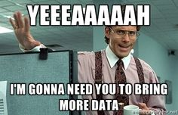
Feature Enrichment
When training a model you can
Add more training records
Find more rows!
OR
Add more information
Find more columns!
Kwartler

Slide 50
Why is Feature Enrichment Effective?
Using qualitative or technical expertise to derive new features for machine learning.
$$f\left(Modeling Results\right)=the Algo+Parameters+Data provided$$
Better features means flexibility.
less than optimal models can still yield good results
Betters features means simpler models.
less than optimal parameters can still yield good results
Better features means better results.
“The algorithms we used are very standard for Kagglers. We spent most of our efforts in feature engineering.” Xavier Conort describing his winning “Flight Quest” submission
Way to differentiate & squeeze out more accuracy
Kwartler

Slide 51
Data Enrichment aids Model Performance
Feature Enrichment is the act of adding new information to your dataset. You are enriching your existing data, often with public or 3rd party data.
Existing Data
New Data
There are limits to what an organization has internally for data.
Companies exist solely to enrich data sources.
Kwartler

Slide 52
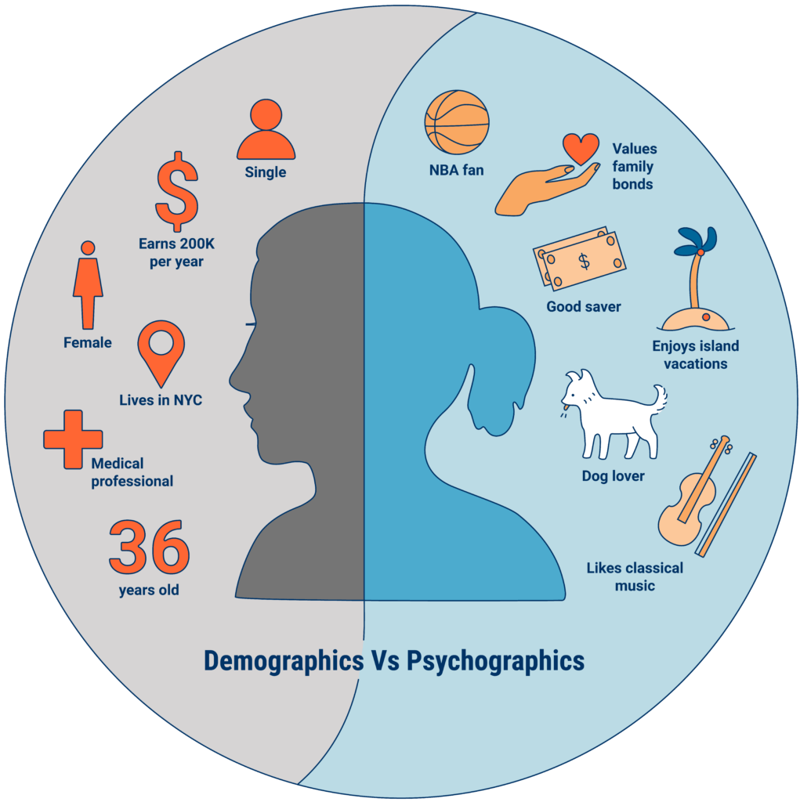
An example of Data Enrichment
They could buy data about employees to have a more complete picture.
An organization may collect some information about employees during interactions.
https://www.cbinsights.com/research/what-is-psychographics/
Kwartler

Slide 53


Modeling with Feature Enrichment is Widespread
Used social media information of individual and friends to model voting tendencies
Uses 3rd party data to predict if a household member has diabetes for marketing.
Most consumers are not aware the type and amount of data that is available about them.
Kwartler

Slide 54
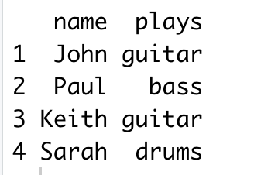
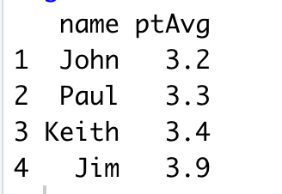
Feature Enrichment Requires a Join
X
Y
Instruments
Grades
Students playing instruments
Student Grades from Honors Science Class
It’s kind of like a vlookup…matching records from one table to another.
Kwartler
Notes:
Very common to append the existing data as the left side
Grades could have millions of more records than instruments table. The only rows that are kept are the instrument table X

Slide 55

Meet Donor Bureau
Kwartler

Slide 56
Company Overview
Founded in 2011
DonorBureau spun out of a direct mail agency
Works with non-profits to optimize their direct mail fundraising
Data Stats:
900M past mail transactions
140M past donations
40M individuals
Kwartler

Slide 57
Modeling Problem
Two modeling problems
What acquisition targets should NOT get mail?
What donor cultivation targets should get mail?
Acquisition modeling
Drop bottom 20% of list to be mailed
Goal is to have the top 80% gross twice as much as the bottom 20%
Cultivation modeling:
Add names to the monthly 10k piece cultivation mailings
Find 2k additional names per month to mail from a 40k donor file
Kwartler

Slide 58
Let’s Practice
Open A_DataPreProcessingEngineering:
Variable | Description
rowID | Appended Row ID - noninformative
uniqueID | Unique Identifier – noninformative
Zip | Zip code group to anonymize
Homeowner | Y/N if they own a hom
NUMCHLD | Number of children in house
Income | Household Income
Gender | M/F
Wealth | Wealth rating uses median family income and population statistics from each area to index relative wealth within each state. The segments are denoted 0-9, with 9 being the highest wealth group and zero being the lowest. Each rating has a different meaning within each state.
Variable | Description
HV | Avg Home Value in potential donor's neighborhood in hundreds of dollars.
Icmed | Median Income in potential donor's neighborhood in hundreds of dollars.
Icavg | Avg Family Income in potential donor's neighborhood in hundreds of dollars.
IC15 | % earning less than $15K in potential donor's neighborhood.
NUMPROM | Lifetime # of promotions received to date
RAMNTALL | Dollar amount of lifetime gifts to date.
MAXRAMNT | Dollar amount of largest gift to date.
LASTGIFT | Dollar amount of most recent gift.
TOTALMONTHS | Number of months from last donation
TIMELAG | Number of months between first and second gift.
AVGGIFT | Average dollar amount of gifts to date.
Y1_Donation | Y/N did they donate
Y2_DonatedAmt | Dollar Amt of donation
Kwartler
Notes:
2 identifier col
2 y binary and continuous

